Slide 1
The rise of the Big Data era:
The case for Network Monitoring
Evangelos Markatos
FORTH-ICS and U of Crete, Crete Greece
SysSec project coordinator

Slide 2
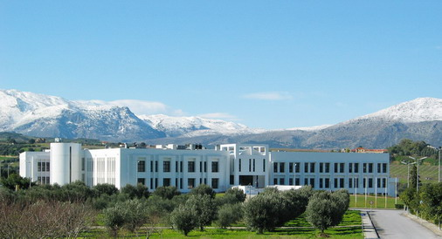
Background
Evangelos Markatos
Professor of Computer Science
University of Crete
Founder and Director
DCS Lab at FORTH-ICS

Slide 3
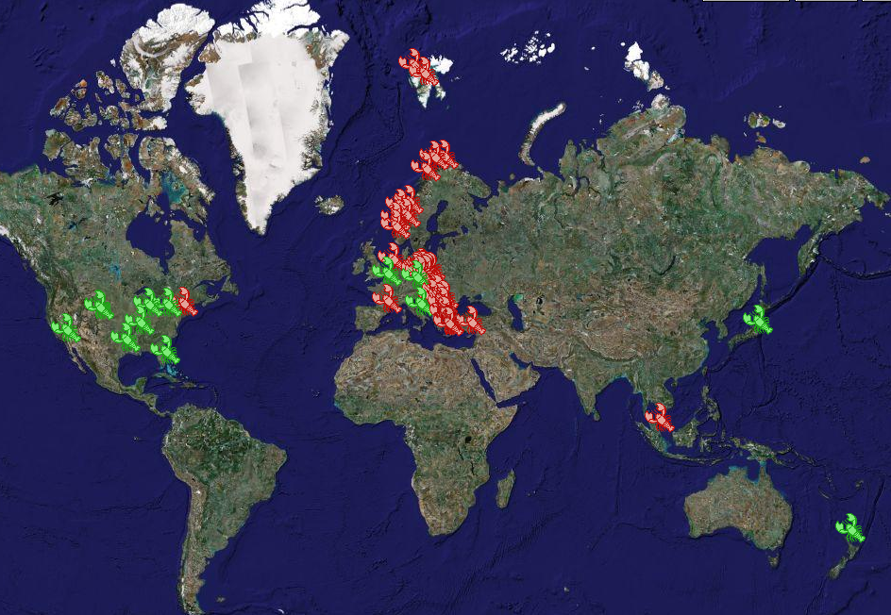
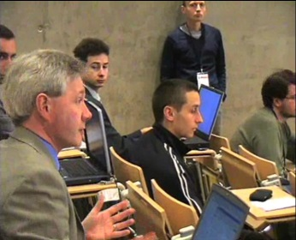
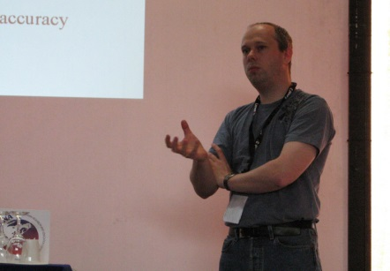
Background: Coordinator of LOBSTER
Coordinated the largest passive network monitoring
infrastructure in Europe 2004-2007
More than 20 LOBSTER sensors
In 10 countries
In 3 continents
400,000
Polymorphic attacks captured
Notes:
Provide one slide for each of the main RTD results of the lab.
Keypoints are meant to explain why the achievement is considered important/useful/etc…

Slide 4
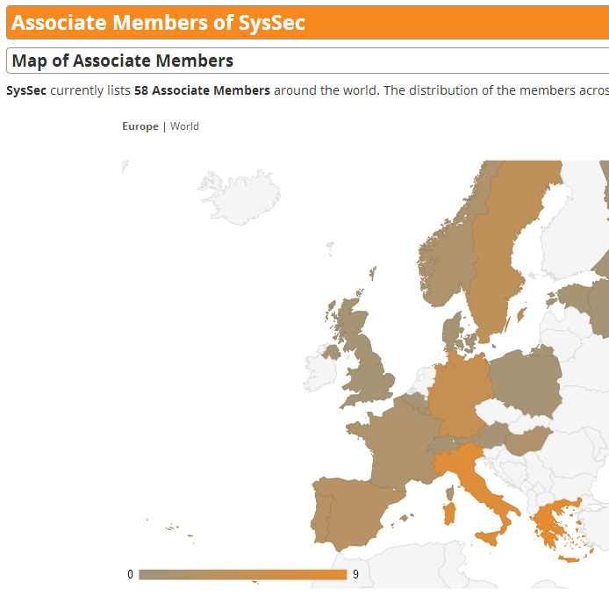
Backgroud: Coordinator of SysSec NoE
Coordinate the European Network of Excellence
in Systems Security (2010-2014)
8 partners
> 50 Associated partners
Coordinate
Research Activities
Think-tanks
Summer Schools

Slide 5
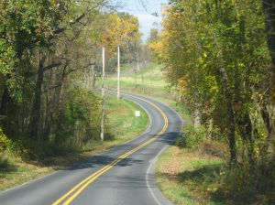
Outline
The Rise of the Big Data
Big Data in Network Monitoring
Privacy issues and solutions
Funding Opportunities

Slide 6
Outline
The Rise of the Big Data
Big Data in Network Monitoring
Privacy issues and solutions
Funding Opportunities

Slide 7
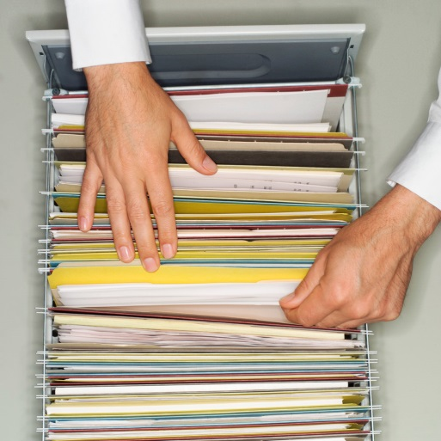
The rise of Big Data
Science, Governments, and the Market
increasingly depend on accurate data
their growth, their existence depends on data
Biology: MIT
Global Alliance for Genomics – Broad Institute
Physics: CERN
Governments: open data
www.data.gov
MASS hackathon
37 billion miles data challenge

Slide 8
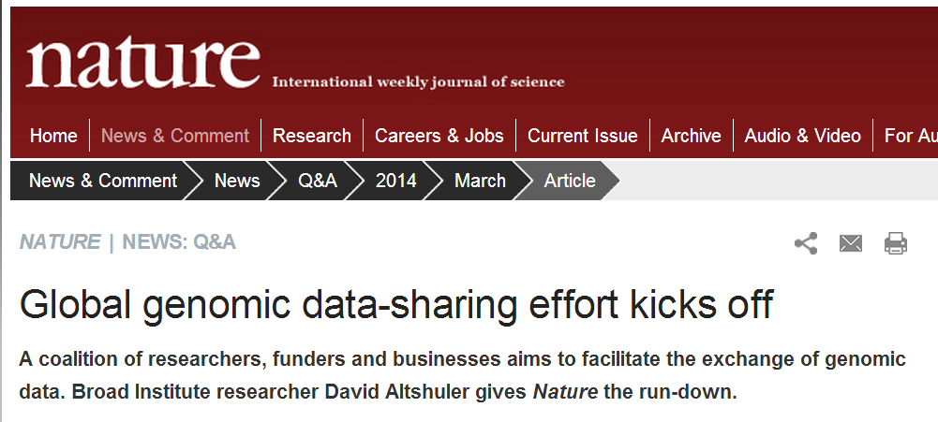
The rise of Big Data
Science depends on Big Data

Slide 9
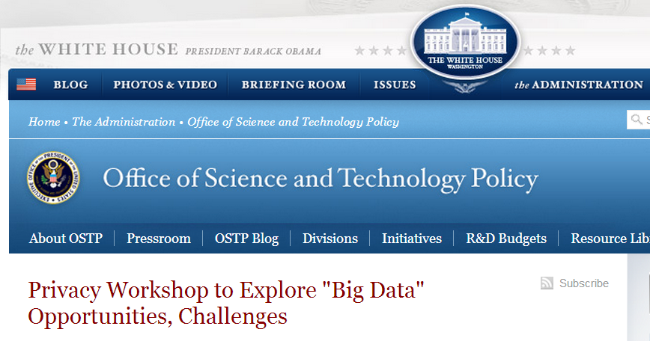
The rise of Big Data
Governments release Big Data

Slide 10
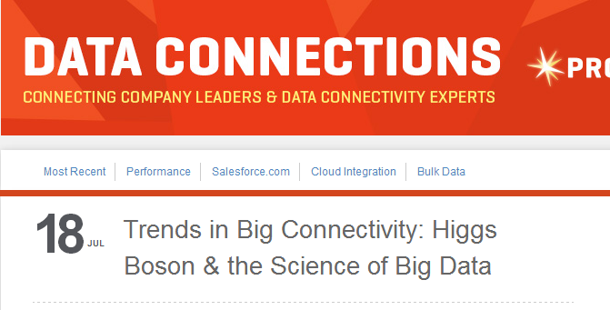
The rise of Big Data
Physics depend on Big Data

Slide 11
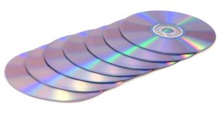
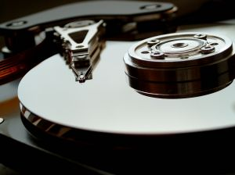
Driving Factors
Scientists
Good data lead to good science
The Nobel Prize in Physics 2013 was awarded jointly to François Englert and Peter W. Higgs "for the theoretical discovery of a mechanism that contributes to our understanding of the origin of mass of subatomic particles, and which recently was confirmed through the discovery of the predicted fundamental particle, by the ATLAS and CMS experiments at CERN's Large Hadron Collider"
Governments
www.data.gov
Corporations
Innovation
All depend on the availability of Big Data

Slide 12
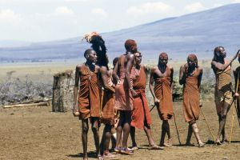
Why?
Why do we capture Big Bata?
Because it is there!
Because it is cheap!
The Human genome project cost $2,700,000,000 (..billions)
The human genome today costs $ 1,000
Because it promotes
Innovation
e.g. geo-based services
Science
physics, biomed, IT, etc.
The Market

Slide 13
Can we revert it?
Can we avoid using Big Data?
Can we go back?
to small data…
to little data…
to simple life…
It is not clear that we can
Everyone seems rushing
To innovate on the data

Slide 14
The Question is…
not whether we are going to use Big Data
But
how we are going to use them

Slide 15
Outline
The Rise of the Big Data
Big Data in Network Monitoring
Privacy issues and solutions
Funding Opportunities

Slide 16
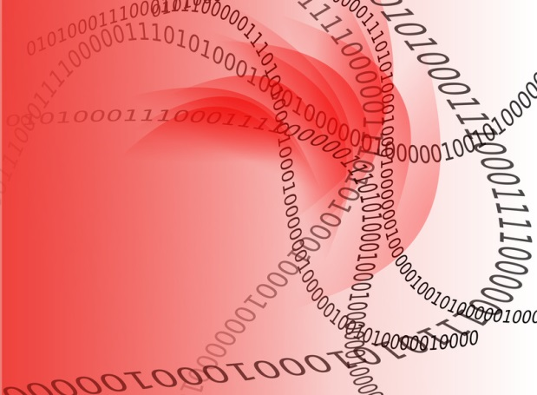
Big Data in Network Monitoring
Passive Network Traffic Monitoring
Records information on the Internet
Packet-level (with or w/o payload)
Flow-level
A 10 Gbps line creates
105 Tbytes of data per day!

Slide 17
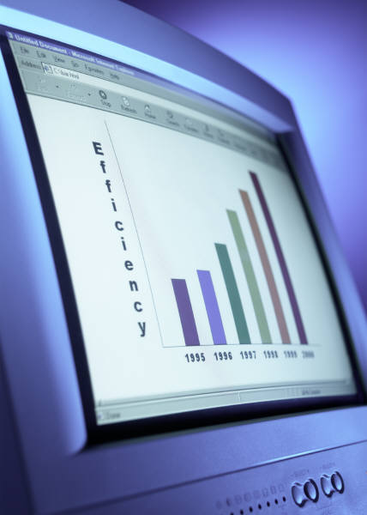
Who cares about Network Monitoring data?
Researchers
Understand the Internet
Understand people
Explore security issues
ISPs
Corporations
Serve their customers
Advertisers
Governments
Serve their citizens

Slide 18
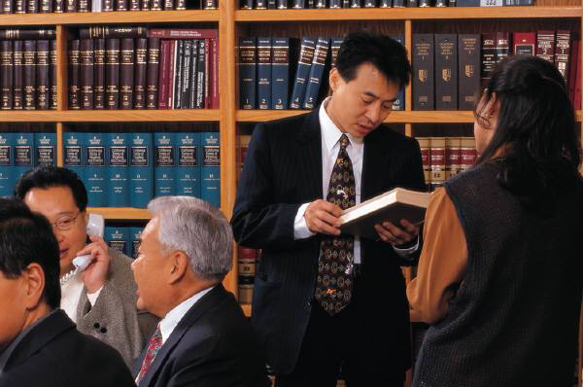
Who cares?
Researchers
How do people use the Internet?
80’s, 90’s, 00’s , …
Why do they use it?
How can we improve their experience?
Can we use the data to make large-scale research?
Living labs?
Large-scale experiments? Epidemiology studies?
What is the geo pattern of a flu epidemic?
Sociology studies?
How does violence propagate through twitter?
Security Issues

Slide 19
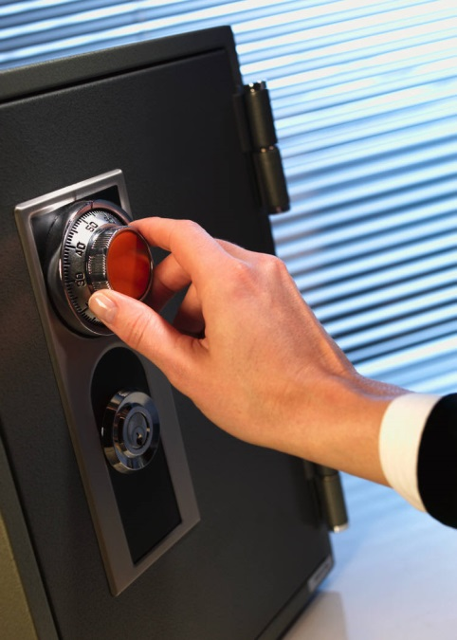
Who cares?
Researchers
Security Issues
Port scans
Intrusion Detection/Prevention Systems
SPAM
DNS attacks
Botnet Detection – Monitoring
Malware drive-by downloads
Javascript code injection attacks

Slide 20
Who cares?
Corporations: Provide better service to customers
Keep customers happy
Give them what they want (today):
Faster, bigger, better
Give them what they will want (tomorrow) :
Give them what they want before they even ask for it
This implies
lighting speed of information delivery
Data mining and data prediction
Drive up sales
Match advertisers with customers

Slide 21
Outline
The Rise of the Big Data
Big Data in Network Monitoring
Privacy issues and solutions
Funding Opportunities

Slide 22
Privacy
Is there a privacy concern?
Wherever there are user data
privacy is bound to be an issue
Users may not be comfortable sharing their data
Medical issues? (e.g. alcoholism)
Minority issues?
Problems of the teenagers in the family?
Substance abuse?

Slide 23
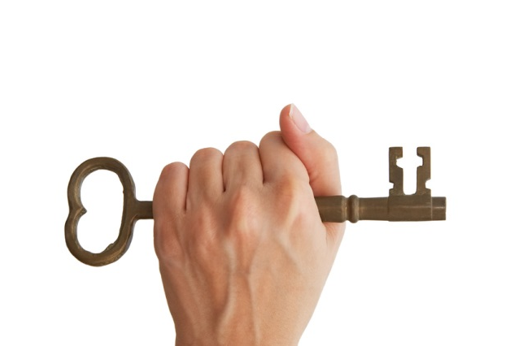
Good news! We are not alone
Governments, Corporations, everyone
need to solve the same privacy problems
need to define privacy-related practices
need to be auditable to third-party agencies

Slide 24
Any solutions to the privacy problem?
Differential privacy
K-anonymity
Give users incentives to give up their privacy
i.e. volunteers, such as the mechanical turk
Purchase data from users who are willing to sell them
Or give them some offers instead

Slide 25
Differential Privacy
Motivation:
User: “I do not feel comfortable being included in a dataset. I feel that if you share the dataset, one might find private information about me.”
Researcher: “No problem. I will not share the dataset. I will just respond to queries.”
User: “Even then one might find information about me”
Researcher: “No problem. I will give the same answers whether you are included or not.”
User: “How can you do that?”
Researcher: “I will add noise”

Slide 26
Differential Privacy - Examples
Approach: Add random noise to the response ☺
Reply =accurate_value +- RANDOM_NOISE
Example:
What is the average salary of people in the Database?
100,000 euros
Take 2: What is the average salary of people in the DB?
95,000 euros
Take 3: What is the average salary of people in the DB?
101,000 euros

Slide 27
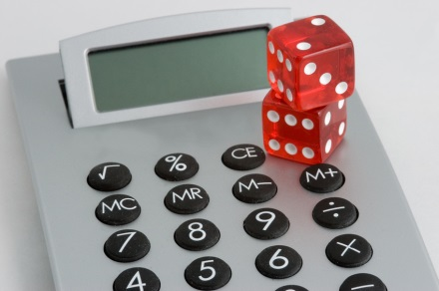
Differential Privacy - Noise
How much noise to add?
Depends on the kind of the queries
Rule of thumb:
Add noise that is large enough to mask the effects of the largest record in the database
The math:
Probability (response | user is included in the dataset) $≅\left(1+ε\right)×$ Probability (response | user is not included in the dataset)
For a very small epsilon

Slide 28
Differential Privacy - Summary
Do not share data
Just respond to queries
Add random noise to each response
The noise should be large enough to
Mask the contribution of any individual record to the query result

Slide 29
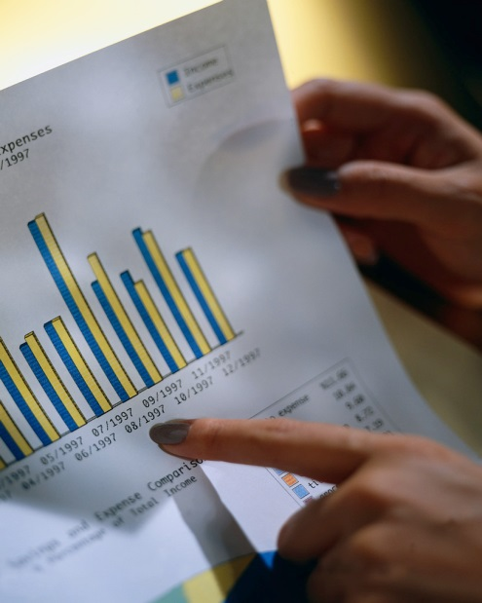
K-anonymity
Share data with the researchers
Frequently used in medical-related studies
Make sure you anonymize data first
Remove names
How about addresses?
Remove them as well?
How about birth dates?
I guess it is OK to leave them in
How about zip codes?
I guess it is OK to leave them in

Slide 30
K-anonymity: the problem
Pseudo-identifiers
such as zip code, birth dates
May still identify a person if correlated with
external information
e.g. how many people have
zip code 14620 and were born on 12/12/1997?
Check it out at: http://aboutmyinfo.org/
So after removing names
Pseudo-identifiers can be used to ID a person

Slide 31
K-anonymity: The solution
There should always be at least “k” people
With the same pseudo-identifiers
e.g. “k” people
born in 12/12/1994 with a zipcode of 14620
If you can not find “k” people as above
generalize the pseudo ids in the dataset:
Zipcode: 146**
Birth date: */12/1994

Slide 32
K-anonymity
For every user
There are “k” other users that “look like” him/her
i.e. have the same pseudo-ids

Slide 33
Privacy: summary
K-anonymity
Give anonymized traces to scientists
Make sure that each user in the data “looks like” k others
Differential privacy
Do not give data to scientists
not even anonymized
Answer the queries they send
Make sure to add noise large enough
To mask the presence in the trace of any individual user

Slide 34
Outline
The Rise of the Big Data
Big Data in Network Monitoring
Privacy issues and solutions
Funding Opportunities

Slide 35
Possible Funding
Call for proposals
by the European Commission
INFRADEV-1-2014: Design Studies
New leading-edge research infrastructures in all fields of science and technology are needed by the European scientific community…
The aim of this activity is to support the conceptual and technical design and preparatory actions for new research infrastructures, which are of a clear European dimension and interest.
Deadline: September 2nd 2014

Slide 36
Possible Funding II
A possible proposal would propose a design study
For a big-data infrastructure in network monitoring
Propose and implement the legal framework
Propose and implement the technical framework
Formulate user responsibility and education on
Privacy, and
Best practices when using data
Operate a pilot system

Slide 37
Possible funding III
Why?
Unique data set: Historical data
Very few other places that you can go back in time
Complete Data: The same population
Lots of Data
The Educational/Research Traffic for an entire country
It will enable Network Science
At an unprecedented scale
It will enable Security Research
If successful others will follow

Slide 38
Possible Funding IV
Who should be involved?
SWITCH - ETHZ
Other NRNs that have experience in passive network traffic monitoring
Other organizations that share data
Network data (CAIDA?)
How about genomics?
or medical-research-related data curators?
Show support from most EU Universities
Show that they want to access these data
Letters of support?

Slide 39
Possible Funding V
Experience?
ETHZ and FORTH were involved in NoAH
a successful Design Study for Security
Received EU funding
Implemented a honeypot-based infrastructure
Operated it for several years
Some of it is still operational
Lots of follow-up projects
WOMBAT, Geant, SysSec, …

Slide 40
Summary
Big Data seem to be one-way road
For science and corporations
Lots of people work on the issues
and care for the results
There seems to be funding to support
an infrastructure on network monitoring data
Infrastructure Design Study

Slide 41
The rise of the Big Data era:
The case for Network Monitoring
Evangelos Markatos
FORTH-ICS and U of Crete, Crete Greece
SysSec project coordinator

