Slide 1
NIS WG3 3rd meeting, April 29th
WG3 Secure ICT Research & Innovation

Slide 2
NIS WG3 Meeting
Secure ICT Landscape Deliverable
Mari Kert, Javier Lopez
Evangelos Markatos, Bart Preneel
8 April 2014
Notes:
Construcción de documentos Accesibles
18/02/2009
2

Slide 3
Secure ICT Landscape Deliverable

Slide 4
What is it?
Describe State of the Art
In Cyber Security
What are the Treats?
What are the Existing Defenses for each threat?
What are the Research Challenges?
What are the Existing Tools?

Slide 5
How did we do it?
Created 4 Groups:
@steering
@contributors
@wg3
@stakeholders

Slide 6
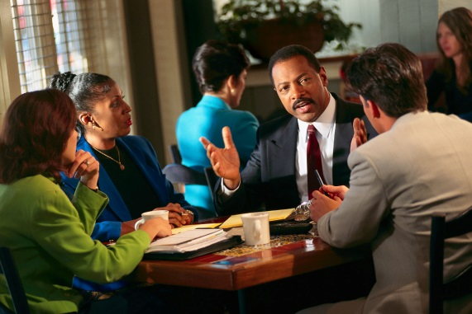
How did we do it?
@steering created a Table of Contents
Asked for feedback from @wg3 and @stakeholders
In parallel,
those who gave feedback (and wanted)
became part of @contributors

Slide 7
Contributors
Magnus Almgren, Chlamers University of Technology
Elias Athanasopoulos, FORTH
Henk Birkholz, Fraunhofer SIT
Hugh Boyes, University of Warwick
Hervé Debar, Télécom SudParis
Sotiris Ioannidis, FORTH
Roy Isbell, University of Warwick
Nicola Jentzsch, DIW
Wouter Leibbrandt, NXP Semiconductors
Joachim Posegga, University of Passau
Michalis Polychronakis, Columbia University
Vassilis Prevelakis, Technical University, Braunschweig
Ali Rezaki, Tubitak
Rodrigo Roman, University of Malaga
Carsten Rudolph, Fraunhofer SIT
Bjornar Solhaug, SINTEF
Christophe Sprenger, ETH Zurich
Theo Tryfonas, University of Bristol
Paulo Verissimo, University of Lisbon
Tim Watson, University of Warwick

Slide 8
The procedure
@steering
created an “example” section
to be used by the rest of the contributors
assigned the sections to authors
and reviewers as well
Text has been steadily flowing
Some is still trickling

Slide 9
Structure
Introduction
Basic Technologies
Internet of Things - Cloud
Application Domains
Conclusions

Slide 10
Structure
Basic Structure of Each section:
Introduction
What is it?
Current Status
What has been done?
Research Challenges
What needs to be done?
Existing Tools (if applicable)

Slide 11
Next Steps
Quality assurance
Receive Feedback
Complete Reviews
Address some of the Research challenges ☺

Slide 12
Example Section:
Intrusion Detection Systems
Introduction
Rule-based, Anomaly-based
Current Status
Research Challenges
The Changing Security Paradigm
No more perimeter security
Speed
Whole System Image
Not only network image
New models for attack patterns
String matching and automata are not enough

Slide 13
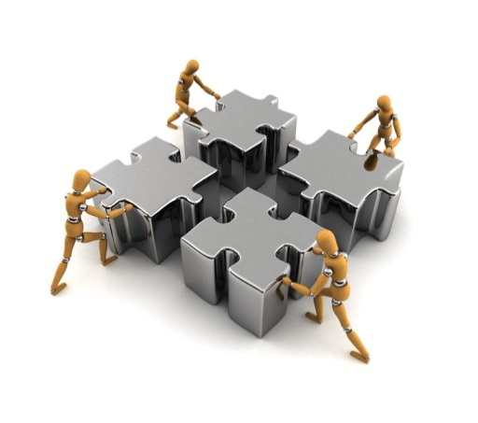
Summary
Secure ICT Landscape Deliverable
Have mobilized the community
At several different levels
@contributors, @wg3, @stakeholders
Text flows in
Quality assurance runs in parallel

